Slide 1
Data Structure & Algorithm
Lecture 1 – Selection & Insertion Sort
JJCAO
Steal some from Prof. Yoram Moses

Slide 2
The Sorting Problem
Example:
Input: A sequence of n numbers $<a_{1},a_{2}, …,a_{n}>$
Output: A permutation (reordering) $<b_{1},b_{2}, …,b_{n}>$of the input sequence such that $b_{1}≤b_{2} …≤b_{n}$

Slide 3
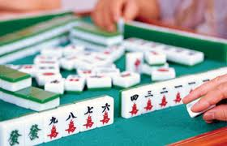
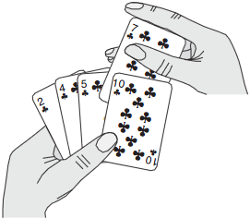
Why is sorting worth so much attention?
Sorting is basic building block
Historically, ¼ mainframe cycles were spent sorting data [Knu98]. It remains most ubiquitous in practice.
Notes:
Typical computer science students study the basic sorting algorithms at least three times before they graduate: first in introductory programming, then in data structures, and finally in their algorithms course.
why we review the standard sorting when you are better off not implementing them and using built-in library functions instead.

Slide 4
Algorithm Efficiency
To sort 10 million numbers:
Insertion sort: $O(c_{1}n^{2})$, $c_{1}$?=2
Merge sort: $c_{2}n\log{n}$, $c_{2}$?=50
Many important problems can be reduced to sorting, so we can use our clever O(n log n) algorithms to do work

Slide 5
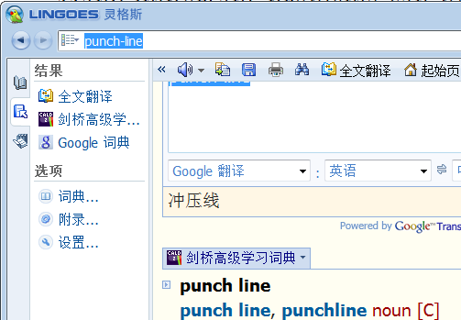
Applications of Sorting - Searching
Binary search tests whether an item is in a dictionary in O(log n) time, provided the keys are all sorted

Slide 6
Applications of Sorting - Closest pair
Given a set of n numbers, how do you find the pair of numbers that have the smallest difference between them?
Once the numbers are sorted, the closest pair of numbers must lie next to each other somewhere in sorted order. Thus, a linear-time scan through them completes the job, for a total of O(n log n) time including the sorting.
For point cloud processing: k-nearest neighbors or neighbors in ball

Slide 7
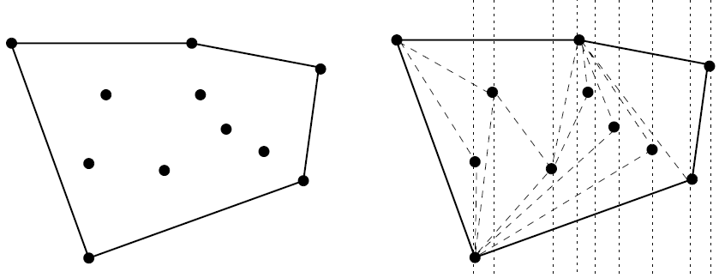
Applications of Sorting – Convex Hall
rubber band stretched over the points
Collision detection in Game, etc.
The total time is linear after the sorting has been done (by x-coordinate)
[Skiena2] ch4.1

Slide 8
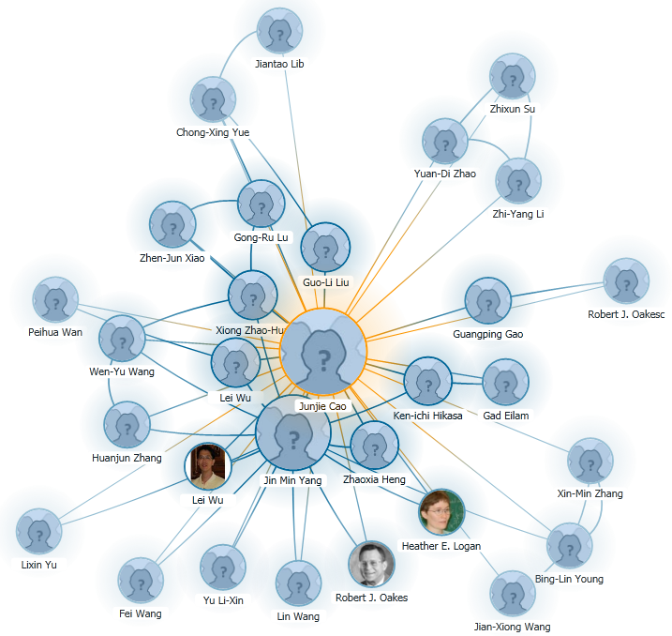
Internet
http://academic.research.microsoft.com/AcademicMap
http://www.arnetminer.org/association.do?m=home&query=junjie+cao&Submit=Search
http://academic.research.microsoft.com/VisualExplorer#13382472

Slide 9
Why review standard sorting when you are better off not implementing them and using built-in library functions instead?
Most of interesting ideas appear in sorting:
divide-and-conquer, data structures, randomized algorithms
Typical computer science students study the basic sorting algorithms at least three times before they graduate: first in introductory programming, then in data structures, and finally in their algorithms course.
Sorting is thoroughly studied. Dozens of diff algorithms exist, most of which possess some particular advantage over others in certain situations.

Slide 10
Sorting!!
It is a rare application where the running time of sorting proves to be the bottleneck
Never be afraid to spend time sorting, provided you use an efficient sorting routine O(nlogn)
Sorting lies at the heart of many algorithms. Sorting the data is one of the first things any algorithm designer should try in the quest for efficiency.

Slide 11
Sorting
Could you think of an algorithm now?
|31 41 59 26 41 58
26 |31 41 59 41 58
26 31 |41 41 59 58
26 31 41 41 58 59

Slide 12
First Idea in Our Head
sort A
for i = 1:n
[B[i], pos] <- min A
A.remove(pos)
end
“Noble’s method”, easy to think, high cost for implementation:
Additional storage space
High cost operation for array even list $O(2c_{1}n^{2})$
min A
for i = 1:n
if tmpv > A[i]
tmpv = A[i]
tmpi = i
end
end
A.remove(pos)
A.Size <- A.size-1
for i = pos:A.size
A[i] <- A[i+1]
end

Slide 13
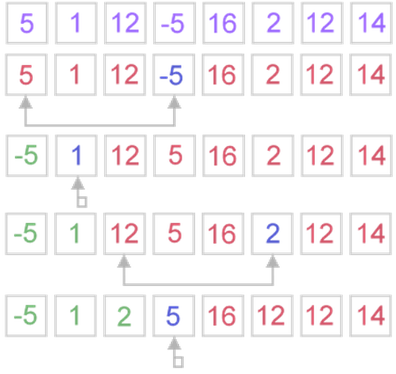
Selection Sort (When no additional storage space is allowed)
O($c_{1}$n²), quite inefficient for sorting large data volumes
Notable for simple-to-code
Algorithm:
sorted one and unsorted one
At each step, algorithm finds minimal element in the unsorted part and adds it to the end of the sorted one
for i = 1:n,
k = i
//invariant: a[k] smallest of a[i..n]
for j = i+1:n
if a[j] < a[k] then k = j
//invariant: a[1..i] in final position
swap a[i,k]
end

Slide 14
Several Sort Algorithms
http://www.sorting-algorithms.com
Notes:
http://www.sorting-algorithms.com

Slide 15
Selection Sort - Complexity analysis
Selection sort performs n iterations, where the average iteration takes n/2 steps, for a total of O(n²) time
Number of swaps may vary from zero (in case of sorted array) to n - 1 (in case array was sorted in reversed order), which results in O(n) number of swaps.
So selection sort requires n - 1 number of swaps at most, makes it very efficient in situations, when write operation is significantly more expensive, than read operation.
for i = 1:n,
k = i
for j = i+1:n
if a[j] < a[k] then k = j
swap a[i,k]
end

Slide 16
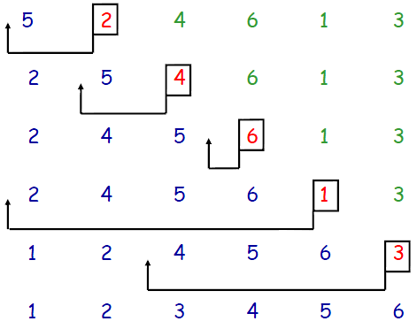
Insertion Sort
Although O(n²), it is applied in practice for sorting a small number of elements (8-12 elements).
Outperforms most of quadratic sorting algorithms, like selection & bubble
works the way many people sort a hand of playing cards
Somewhat resembles selection sort
Notes:
insertion sort is applied to quite small data sets (from 8 to 12 elements). Therefore, first of all, a "practical performance" should be considered. In practice insertion sort outperforms most of the quadratic sorting algorithms, like selection sort or bubble sort.
-- http://www.algolist.net/Algorithms/Sorting/Insertion_sort

Slide 17
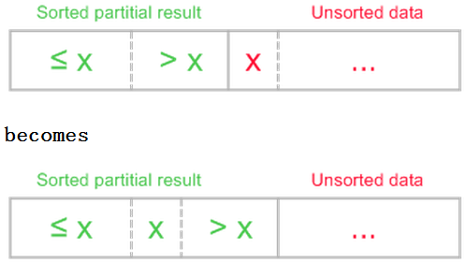
Insertion Sort, $O(c_{1}n^{2})$
sorted one and unsorted one
At the beginning, sorted part contains first element of the array and unsorted one contains the rest.
At each step, algorithm takes first element in the unsorted part and inserts it to the right place of the sorted one.

Slide 18
Ideas of Insertion
for i = 2:n,
//invariant: a[1..i] is sorted end
for (k = i; k > 1 and a[k] < a[k-1]; k--)
swap a[k,k-1]
end
Next implementation eliminates those unnecessary writes.
http://www.sorting-algorithms.com

Slide 19
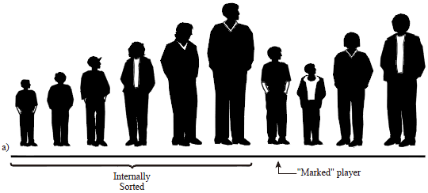
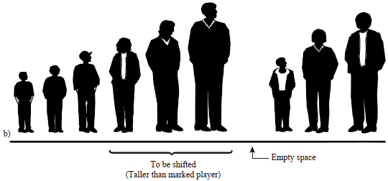
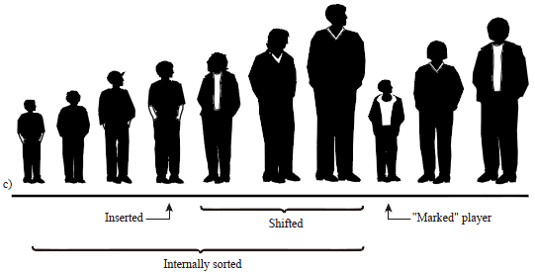
Shifting instead of swapping
[Lafore24]

Slide 20
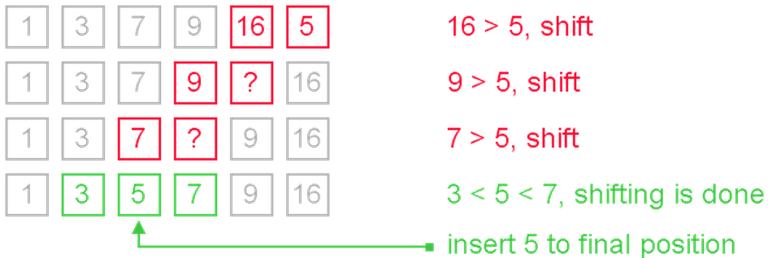
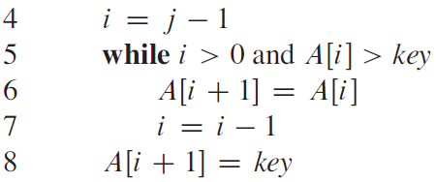
Shifting instead of swapping

Slide 21
Selection & Insertion Sort
Both $O(n^{2})$ , but insertion sort is faster.
It uses the order info to reduce the average n/2 operation furthermore.
for i = 1:n,
k = i
for j = i+1:n
if a[j] < a[k] then k = j swap a[i,k]
end

Slide 22
Pseudo Code
A schematic description of the algorithm which can be easily translated to a “real” programming language
Common in the literature
Easily translated into real code
More information can be found in [CLRS] book

Slide 23
Pseudo Code – Basic Operators
“←” – assignment operator
“for”, “while”, “repeat-until” – loop operators
“if-else”, “case” – condition operators
“return” – return from procedure
Lots of other operators with their meaning obvious from their names, e.g.,
“swap”, “delete”, “new”, ’==‘ etc.

Slide 24
Pseudo Code - Conventions
Indentation indicates block structure
Variables are local to a given procedure
A[i] denotes the i-th element of the array A
A[i…j] denotes the subarray containing elements A[i], A[i+1],…, A[j]
An empty pointer value is denoted by NIL
Fields (and methods) in the composite objects are accessed by “.”,
e.g. Person.id, Person.FirstName, Person.FamilyName, etc.

