Slide 1
Data Structure & Algorithm
Lecture 3 –Algorithm Analysis JJCAO

Slide 2
Recitation - Dynamic Array
Start with an array of size 1, and double its size from m to 2m each time we run out of space. How many times will we double for n elements?
Only 1 + 2 + 4 + 8 + … + 2^i =2^{i+1}=n => i = log(n)
How many times of copy happened?

Slide 3
Recitation - Linked list
以下链表中，不存在NULL的是(In linked lists there are no NULL links in):
A. 单链表Single linked list
B. 双链表Linear doubly linked list
C. 循环链表Circular linked list
D. 以上皆否 None of above

Slide 4
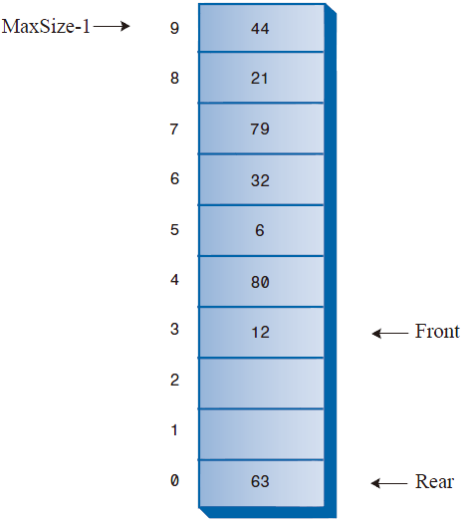
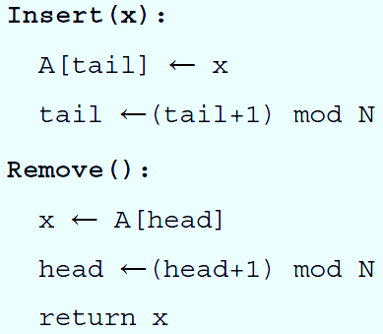
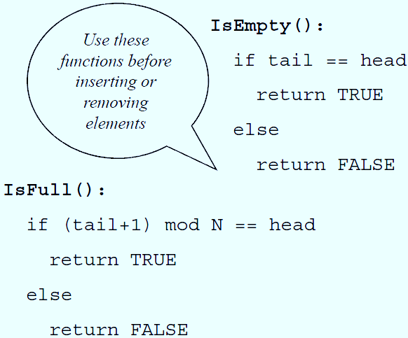
Recitation - A Circular Queue
Write a pseudo code for any of the following operations:

Slide 5
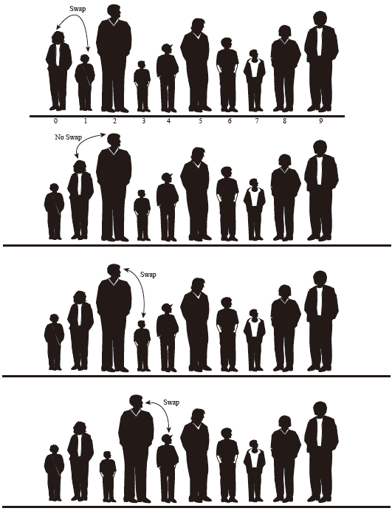
Recitation - Bubble Sort
for i = 1:n,
swapped = false
for j = n:i+1,
if a[j] < a[j-1],
swap a[j,j-1]
swapped = true
break if not swapped
end

Slide 6
Analyzing an Algorithm
Predicting the resources the algorithm requires
Resources: Memory
Communication Bandwidth
Logic Gates
Computation Time

Slide 7
Evaluating an algorithm
Mike: My algorithm can sort ${10}^{6}$ numbers in 3 seconds.
Bill: My algorithm can sort ${10}^{6}$ numbers in 5 seconds.
Mike: I’ve just tested it on my new Pentium IV processor.
Bill: I remember my result from my undergraduate studies (1985).
Mike: My input was a random permutation of 1.. ${10}^{6}$.
Bill: My input was the sorted output, so I only needed to verify that it is sorted.

Slide 8
Processing time is surely a bad measure!!!
We need a ‘stable’ measure, independent of the implementation.

Slide 9
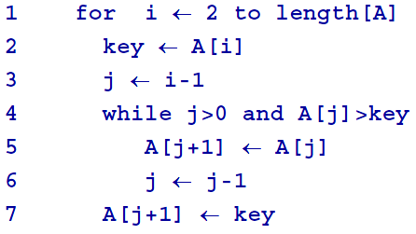
Insertion Sort
n
n
n
n
T(n)=4n+3$\sum_{i=2}^{n}{t_{i}}$
Notes:
n

Slide 10
Insertion Sort - Best Case
Input: <1,2,3,4,5,6> is already sorted
$t_{i}$=1 & $\sum_{i=2}^{n}{t_{i}}$=n-1
T(n)=4n+3(n-1)=7n
This is a linear function of n

Slide 11
Insertion Sort - Worst Case
Input: <6,5,4,3,2,1> (reverse order)
$t_{i}$=i & $\sum_{i=2}^{n}{t_{i}}$=n(n+1)/2
T(n)=4n+3 n(n+1)/2 =4n+3n^2
This is a quadratic function of n

Slide 12
Insertion Sort – Average Case
On average:
$t_{i}$=i/2 & $\sum_{i=2}^{n}{t_{i}}$=n(n+1)/4
T(n)=4n+3 n(n+1)/4 =4n+3n^2
This is a quadratic function of n

Slide 13
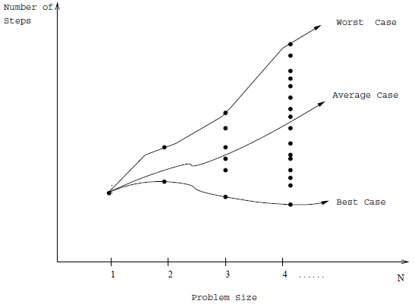
Worst-Case Complexity
The worst case complexity of an algorithm is the function defined by the maximum number of steps taken on any instance of size n.

Slide 14
Best-Case & Average-Case Complexity
The best case complexity of an algorithm is the function defined by the minimum number of steps taken on any instance of size n.
The average-case complexity of the algorithm is the function defined by an average number of steps taken on any instance of size n.
Each of these complexities defines a numerical function: time vs. size!

Slide 15
Worst Case Running Time
Gives upper bound on running time for any input.
A guarantee that the algorithm never takes longer.
For some applications, worst case happens often
Example:
Searching a data base for missing information
Average case is often roughly as bad as w.c.
Example: Insertion Sort, both O(n^2)

Slide 17
The RAM Model of Computation
RAM: Random Access Machine
Each simple operation (+, -, =, if, call) takes 1 step.
Loops and subroutine calls are not simple operations. They depend upon the size of the data and the contents of a subroutine. “Sort” is not a single step operation.
Each memory access takes exactly 1 step.
For a given problem instance:
Running time of an algorithm = #RAM steps
Useful abstraction => allow us to analyze algorithms in a machine-independent fashion.
Notes:
Machine-independent algorithm design depends upon a hypothetical computer called the Random Access Machine

Slide 18
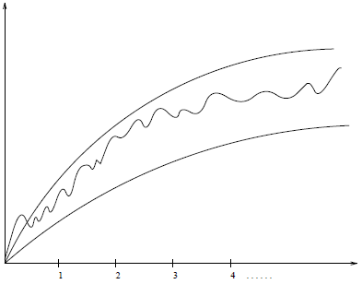
Exact Analysis is Hard!
Best, worst, and average are difficult to deal with precisely because the details are very complicated:
It easier to talk about upper and lower bounds of the function. Asymptotic notation (O, $Θ, Ω$) are as well as we can practically deal with complexity functions.

Slide 19
Order of Growth
We are interested in the type of function the running time was, not the specific function (linear, quadratic,…)
Really interested only in the leading terms
Mostly interested only in the Rate of Growth of the leading terms
⇒ ignore constant coefficients

Slide 20
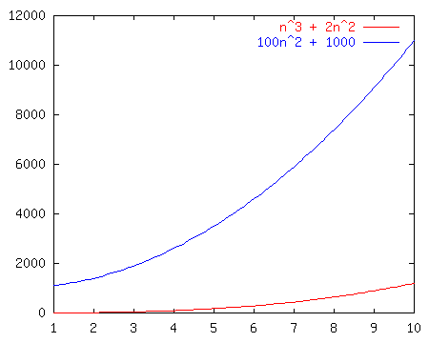
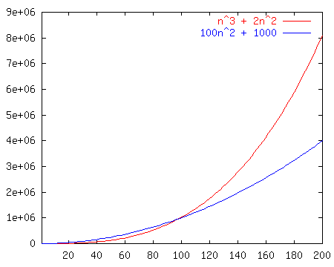
Which Function Grows Faster?

Slide 21
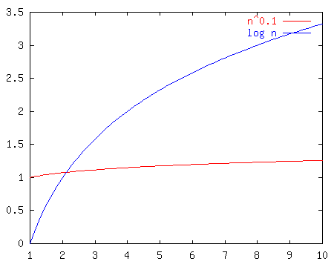
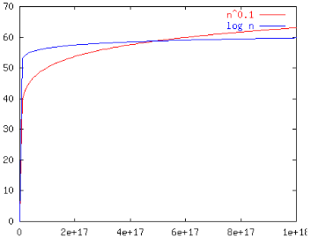
Which Function Grows Faster?

Slide 22
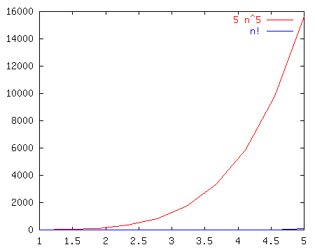
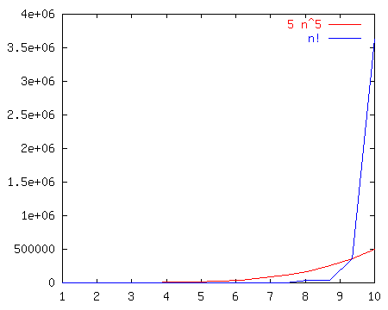
Which Function Grows Faster?

Slide 23
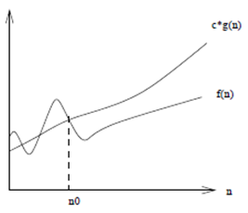
Big Oh notation Upper Bound on Running Time

Slide 24
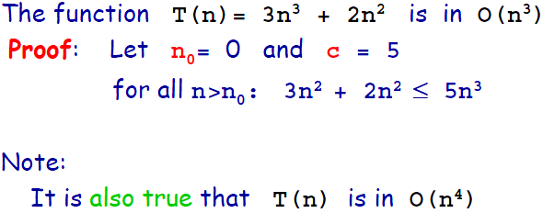
Big-Oh - Example

Slide 25
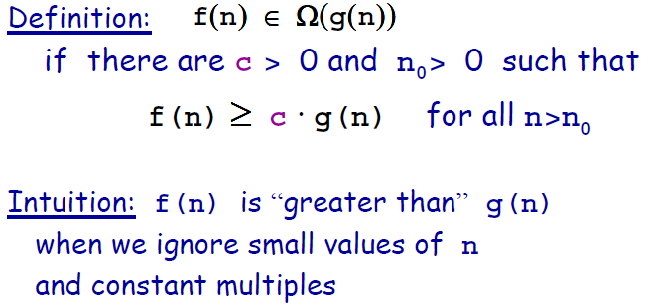
Omega $Ω$ notation Lower Bound on Running Time
Notice that: g(n) ∈$Ω$(f(n)) ⬄ f(n) ∈O(g(n))

Slide 26
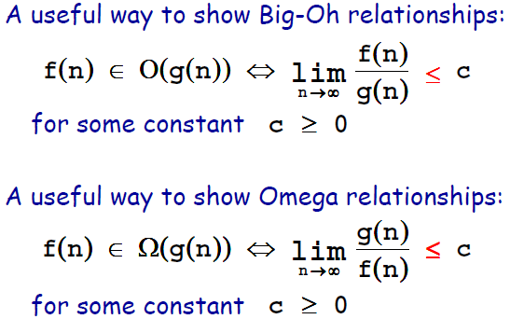
Big-Oh and Omega $Ω$

Slide 27
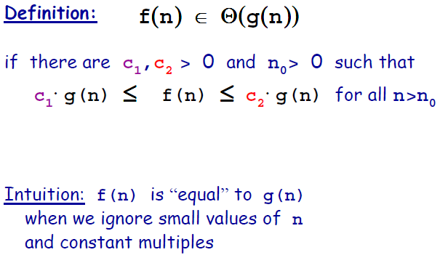
Theta $Θ$ notation: Tightly Bounding Running Time

Slide 28
Theta $Θ$
Note:
f(n) ∈$Θ(g\left(n\right))$
f(n) ∈O(g(n)) & f(n) ∈$Ω$(g(n))

Slide 29
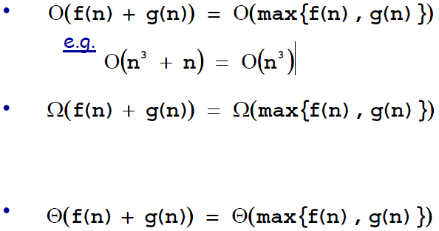
Useful Properties

Slide 31
Proof by Induction
Failure to find a counterexample to a given algorithm does not mean “it is obvious” that the algorithm is correct.
Mathematical induction is a very useful method for proving the correctness of recursive algorithms.
Recursion and induction are the same basic idea:
basis case
general assumption
general case.

Slide 32
Proof by Contradiction
Lets assume that we would like to prove a claim, Claim1
Structure of proof:
Assume that Claim1 is incorrect
Show that this assumption leads to a contradiction
The contradiction should be either to assumptions made in the claim, or to well-known mathematical facts (e.g., 0=1)

Slide 33
Homework 2
Efficient Dynamic Array & Insertion Sort
Deadline: 22:00, Sep. ?, 2011

