Slide 1
Data Structure & Algorithm
Lecture 6 – QuickSort & Randomization
JJCAO
Most materials are stolen from Prof. Yoram Moses’s course.

Slide 2
Something Else
I hear and I forget
I see and I memorize
I write and I understand
Notes:
听而后易忘
看而后能记
写而后理解

Slide 3
ACM ICPC
http://acm.uva.es/
http://acm.zju.edu.cn/
http://acm.timus.ru/
Notes:
王智睿做过1-200道

Slide 4
Content
Quicksort:
Worst-case: θ(n^2),
Expected-case: θ(cnlgn), c is quite small
In place
Behavior of it is complex, so …
Random sampling to prevent worst-case

Slide 5
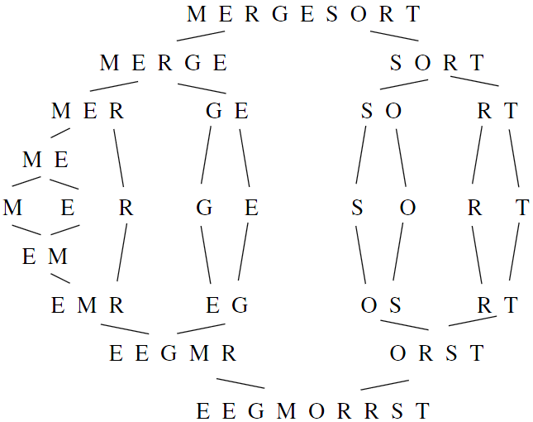
Mergesort(A[1, n]) Merge( MergeSort(A[1,n/2]), MergeSort(A[n/2+1,n]) )

Slide 6
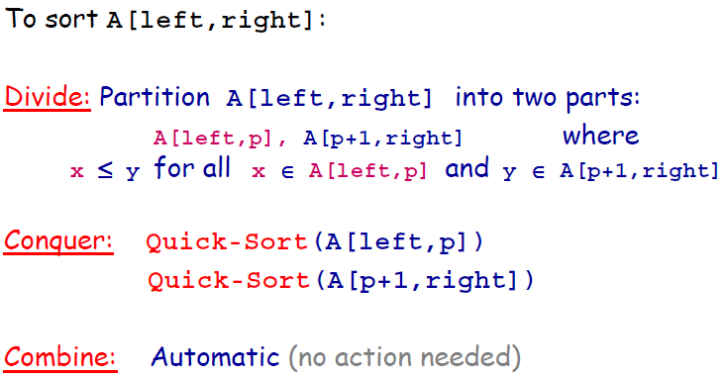
QuickSort

Slide 7
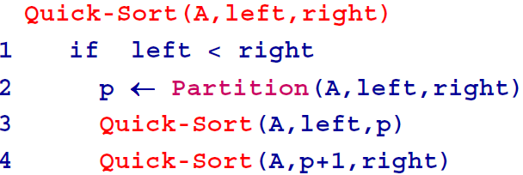
Quicksort
To sort A[1..n]: Quick-Sort(A,1,n)

Slide 8
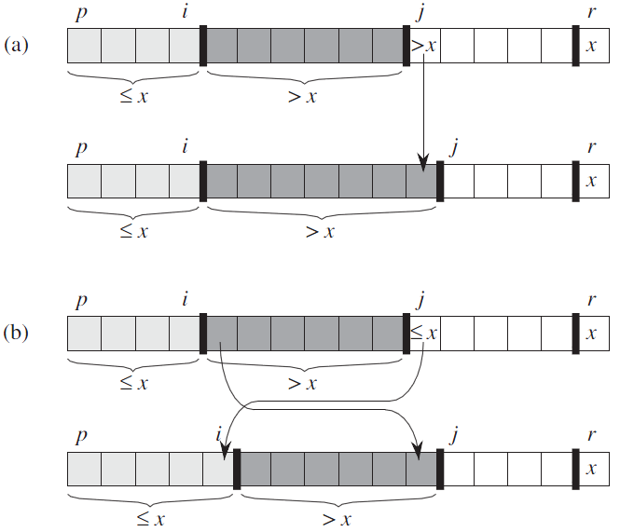
Partition

Slide 9
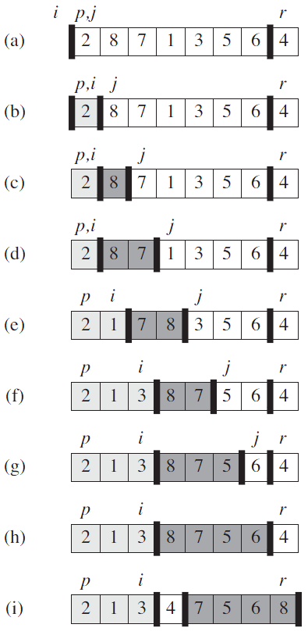
Partition

Slide 10
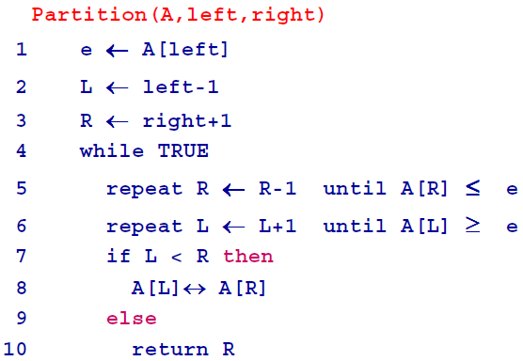
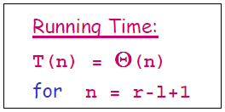
Partition

Slide 11
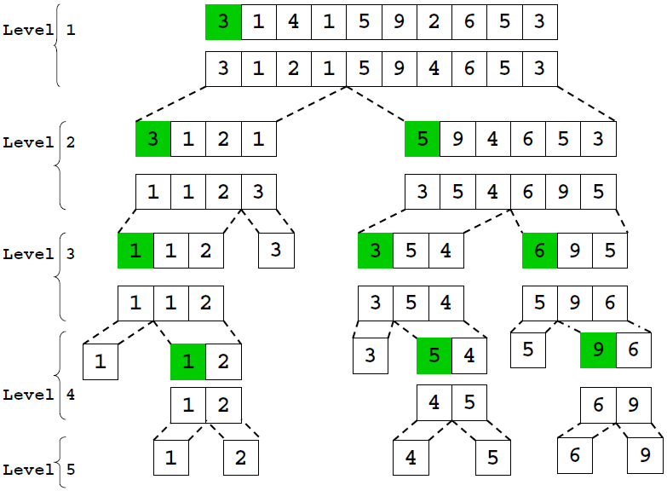

Slide 12
Quick-Sort: Running Time
n = right - left.
T(n) depends on the position of p in the range [left,...,right]

Slide 13
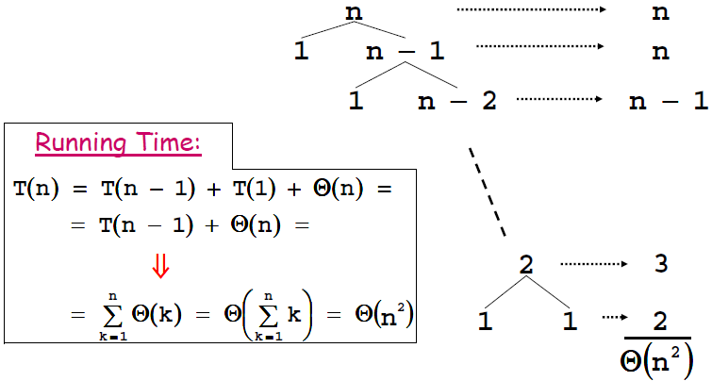
Worst-Case

Slide 14
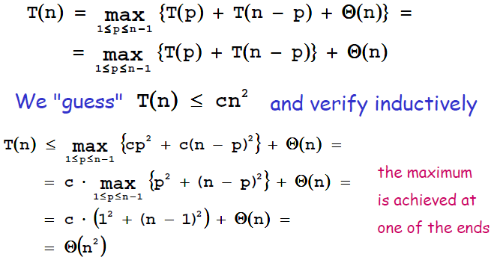
Worst-Case Running Time

Slide 15
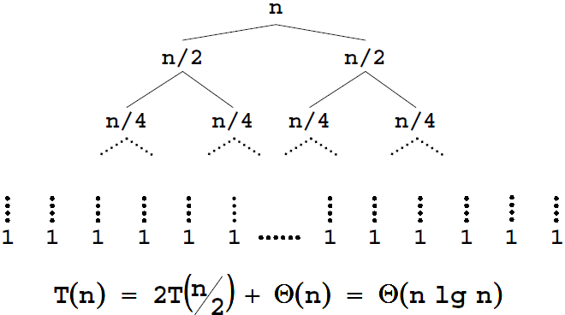
Quick-Sort Best-Case Running Time
θ(n)
2θ(n/2)
n/2θ(2)
The average-case running time of quicksort is much closer to the best case than to the worst case.

Slide 16
Average-Case Running Time

Slide 17
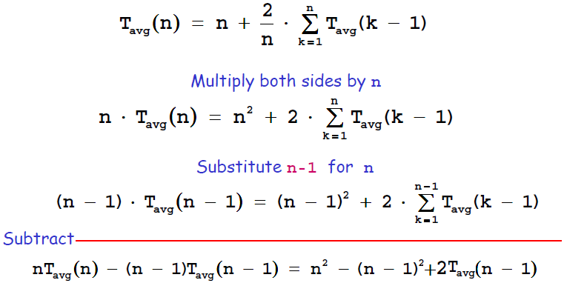
Average-Case Running Time

Slide 18
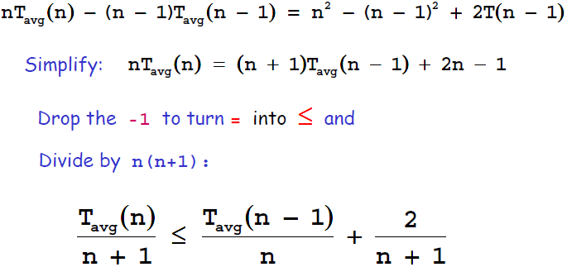
Average-Case Running Time

Slide 19
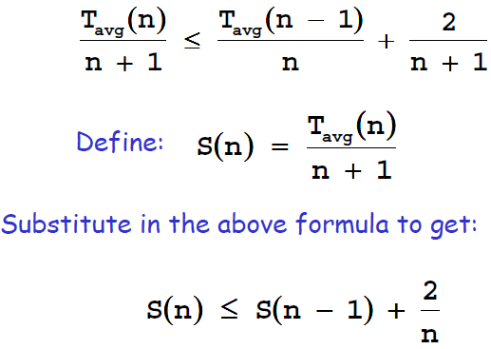
Average-Case Running Time

Slide 20
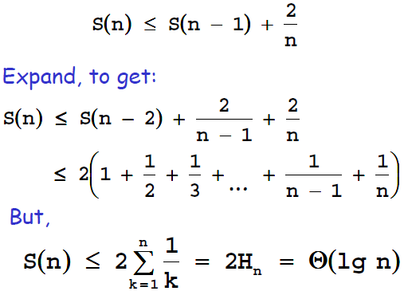
Average-Case Running Time
//Harmonic Series的和，上界是O(lgn)

Slide 21
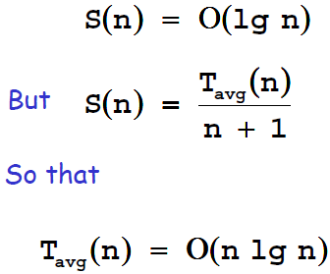
Average-Case Running Time

Slide 22
Randomization
Randomly permute the input (before sorting)
tree of all possible executions most of them finish fast
Choose partitioning element e randomly at each iteration
easier to analyze
same "good" behavior

Slide 23
Randomized-Partition

Slide 24
Variants of Quick-Sort
When we get to small sub-arrays, do not call Quick-Sort recursively
Run Insertion-Sort on the sub-arrays
Go back up recursion and run Insertion-Sort on the nearly sorted array
Different ways to pick the pivot element:
Always pick the first element
Pick a random element
Pick the median of some elements

Slide 25
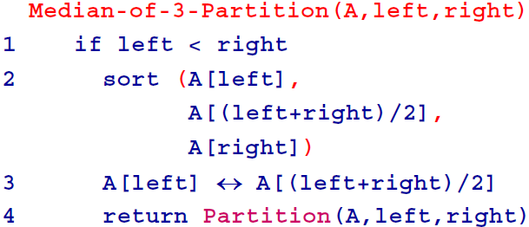
Using Medians of 3

Slide 26
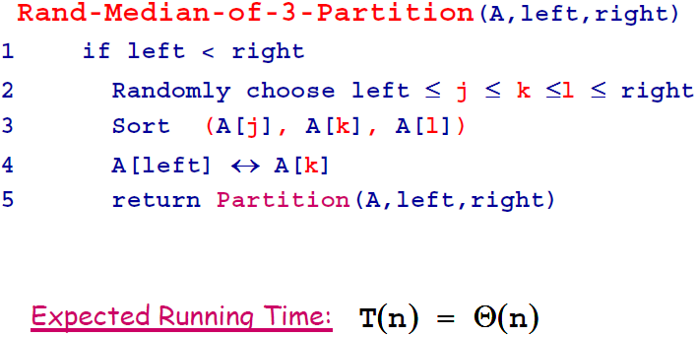
Randomized Medians of 3

Slide 27
Notes on Quick-Sort
Quicksort:
Fast on average: θ(cnlgn), c is quite small
In place
Behavior of it is complex
Worst-case: θ(n^2), but unlikely with medians-of-3
which is unacceptable for large data sets and can be deliberately triggered given enough knowledge of the implementation, creating a security risk.
embedded systems with real-time constraints or systems concerned with security often use heapsort

Slide 28
Homework 4
Hw04-GuiQtScribble
Deadline: 22:00, Oct. ?, 2011

