Slide 1
Data Structure & Algorithm
Lecture 7 – Linear Sort
JJCAO
Most materials are stolen from Prof. Yoram Moses’s course.

Slide 2
Recitation
Bubble Sort : O(n^2)
Insertion Sort : O(n^2)
Selection Sort: O(n^2)
Merge Sort: O(nlgn), stable for not in place implementation, not stable for in place implementation, parallelizes better
Merge sort (easily adapted to implementation based on lists and very large lists stored on slow-to-access media such as disk storage or network attached storage. Heapsort relies strongly on random access, which makes it very slow on media with long access times.
Heap Sort: O(nlgn), stable, in place, more secure than quick sort
Quick Sort: O(nlgn), not stable, in place, usually more fast than heap sort.
Notes:
http://en.wikipedia.org/wiki/Heapsort
http://en.wikipedia.org/wiki/Merge_sort
Merge sort can be easily adapted to operate on linked lists (with O(1) extra space^{[7]}) and very large lists stored on slow-to-access media such as disk storage or network attached storage. Heapsort relies strongly on random access, and its poor locality of reference makes it very slow on media with long access times. (Note: Heapsort can also be applied to doubly linked lists with only O(1) extra space overhead)

Slide 3
Linear Sorting: An Example
Suppose that A[1..n] is a permutation of the values 1,2,…,n
To sort A:
1 for i ← 1 to n
2 B[A[i]] ← A[i]
Running Time: O(n)

Slide 4
Another Example
Again, assume that A[1..n] is a permutation of the values 1,2,…,n
To Sort:
1 for i ← 1 to n
2 while A[i] ≠ i
3 swap A[i] ↔ A[A[i]]
Running Time: O(n)

Slide 5
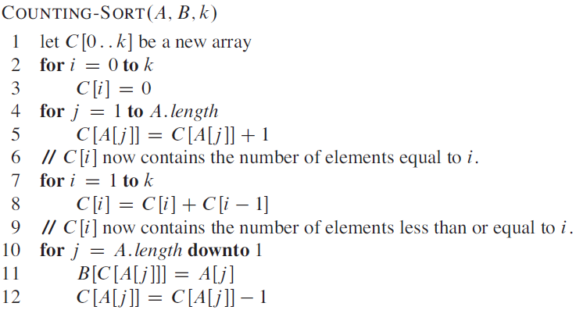
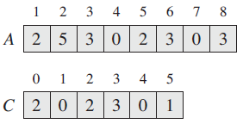
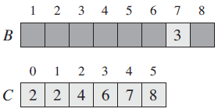
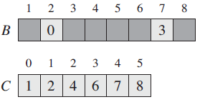
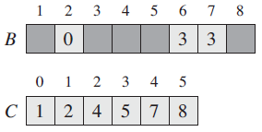
Running Time: O(n+k)
Due to Line 10 it is stable!

Slide 6
Bucket Sort
Like counting sort, bucket sort is fast because it assumes something about the input:
counting sort assumes: the input consists of integers in a small range
bucket sort assumes that the input is generated by a random process that distributes elements uniformly and independently over the interval [0,1)

Slide 7
Bucket Sort
Idea:
Divide the interval to n buckets
Distribute the n input keys into the buckets
Sort the numbers in each bucket
Scan sorted buckets and combine them to produce the output array

Slide 8
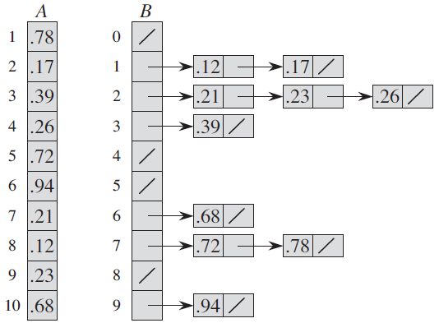
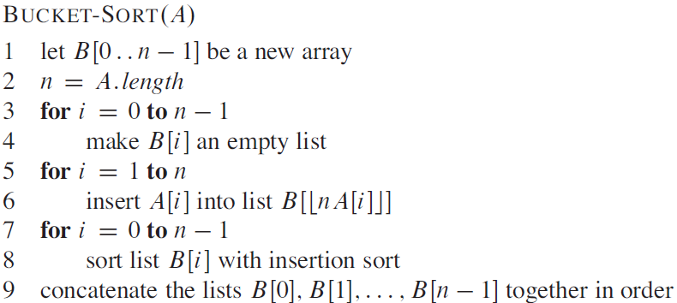
Bucket Sort

Slide 9
Bucket Sort

Slide 10
Problematic Case

Slide 11
How to sorting strings (Lexicographic Order)
Example:
safe < sail < salt < salty

Slide 12
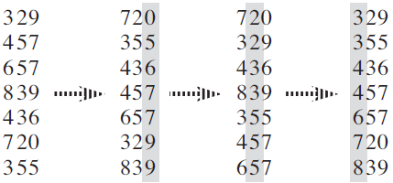
Radix-Sort

Slide 13
General Radix Sort

Slide 14
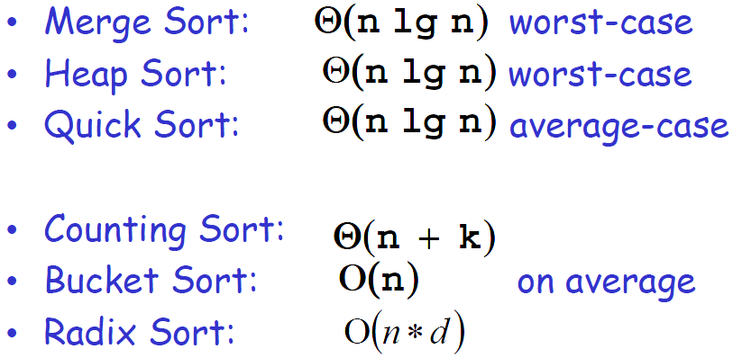
How fast can we Sort?

Slide 15
Comparison Sorts
The only operations allowed on input elements are comparisons between two elements:
Bubble, Insertion, Merge, Heap and Quick sort
Can we do better than nlgn ?
Not with comparisons sorts!
And we’ll prove it now...
Notice: Bucket, Counting and Radix sort are NOT comparison sorts

Slide 16
Decision Tree Model
Only consider the comparisons in the algorithm
Each internal node = one comparison of the algorithm
Start at the root, make the first comparison:
if outcome is ≤ - take the left branch
if outcome is > - take the right branch
Repeat this at each internal node
Every sorting algorithm induces a single tree
Each ordering is represented by a leaf of its own
Notes:
We can view comparison sorts abstractly in terms of decision trees. Control, data movement, and all other aspects of the algorithm are ignored.

Slide 17
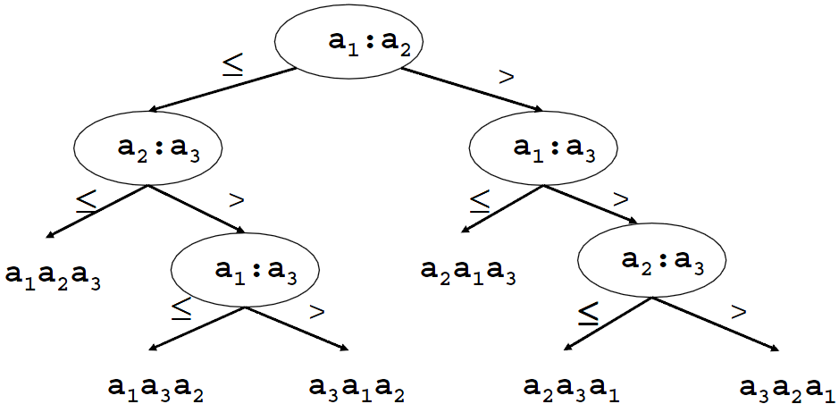
Example: Insertion Sort, n=3

Slide 18
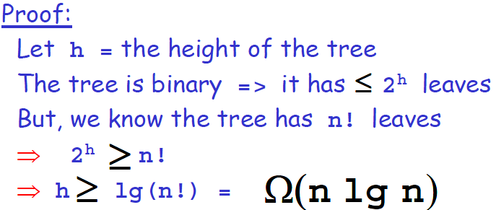
Notes:
[CLRS] equation (3.19)

Slide 19
Homework 4
Hw04-GuiQtScribble
Deadline: 22:00, Oct. ?, 2011

Slide 20
More Lower Bounds
Theorem 1:
Any comparison-based algorithm for finding the
minimum of n keys, must use at least n/2 comparisons
Proof:
Every key must participate in at least one comparison
Each comparison compares 2 elements
⇒ At least n/2 comparisons have to be made

Slide 21
More Lower Bounds
Theorem 2:
Any comparison-based algorithm for finding the minimum of n keys, must use at least n-1 comparisons
Proof:
Every other key must have won at least one comparison.
Each comparison produces at most one winner.
⇒ At least n-1 comparisons have to be made

