Slide 1
Data Structure & Algorithm
Lecture 8 – Hashing
JJCAO
Most materials are stolen from Prof. Yoram Moses’s course.

Slide 2
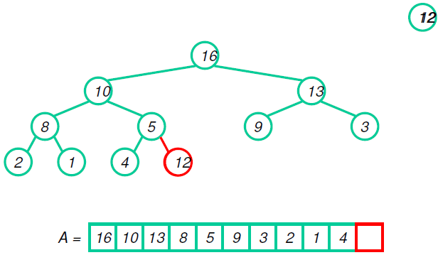
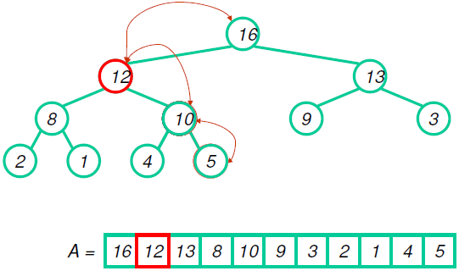
Heap Insert

Slide 3
Hashing
Data structures we have considered
Use comparisons to find items
Good behavior is O(log n) for search and insert
log(100)=6.6 and log(100,000)=16.6
Hash tables
Support only search, insert and delete
Designed for O(1) behavior on each operation.
Efficient use of space: roughly the number of items handled.
Notes:
It is terrible to schedule jobs via list or vector since log(100)=6.6 and log(100,000)=16.6.

Slide 4
Dictionary ADT
U = Universe of possible keys
K$⊑$ U - Set of keys actually handled
Operations: - Search(key)
- Insert(x)
- Delete(x)
Possible implementations: Linked list, BST, Array, Hash table

Slide 5
Terminology

Slide 6
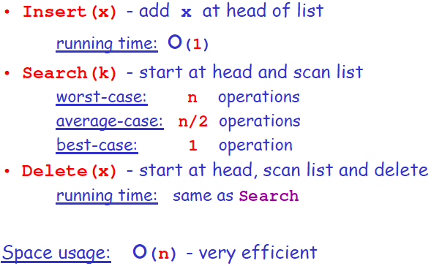
Linked List implementation

Slide 7
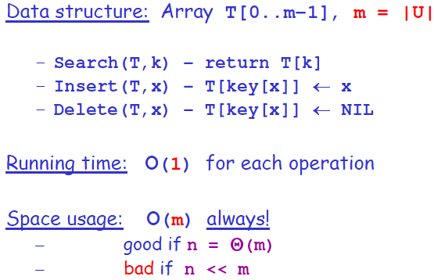
Array implementation

Slide 8
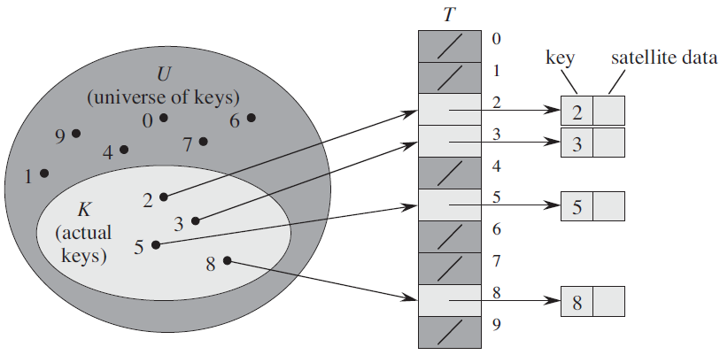
Array implementation - picture

Slide 9
Hash Tables

Slide 10
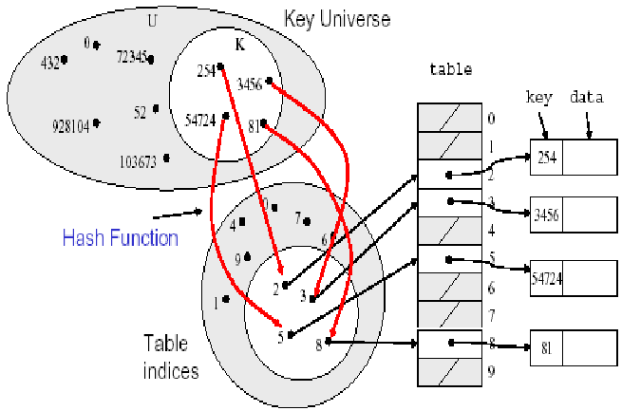
Hashing - picture

Slide 11
Collisions

Slide 12
Choosing a Hash Function
The actual key values matter
They often are a particular subset of U:
English words
I.d. numbers from certain years
Variable names or keywords
Phone numbers
A Hash Function should:
Be easy to compute
Create few collisions:
inverse should be evenly distributed
not be vulnerable to non-random patterns

Slide 13
Perfect Hashing
If all keys are known in advance, can sometimes design a simple one-to-one hash function.
Example:

Slide 14
Division Method - the mod Hash function
A common type of hash function has the form: h(key) = key mod size
where size is the table size m
What if size=12 and all keys are 12k+2 (2, 26, 50,…)
All keys hash to same index (lots of collisions!)
We cannot store more than one key in a cell
Must pick table size carefully: a prime number is usually a good choice for size
Notes:
it is often tempting to let M be a power of two. E.g. M=2^k, for some integer k>1. In this case, the hash function simply extracts the bottom k bits of the binary representation of x. While this hash function is quite easy to compute, it is not a desirable function because it does not depend on all the bits in the binary representation of x
For these reasons M is often chosen to be a prime number. For example, suppose there is a bias in the way the keys are created that makes it more likely for a key to be a multiple of some small constant, say two or three. Then making M a prime increases the likelihood that those keys are spread out evenly. Also, if M is a prime number, the division of x by that prime number depends on all the bits of x, not just the bottom k bits, for some small constant k.

Slide 15
Hashing Strings

Slide 16
Resolving Collisions
Chaining:
Elements are stored outside the table
(Table locations are pointers to "buckets")
Load factor is allowed to be > 1
Open Addressing:
On collision, look for another place, in the table
Load factor must be < 1

Slide 17
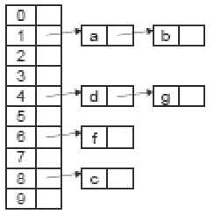
Chaining - picture

Slide 18
Chaining
Linked list at each table location
The table entries are pointers to list heads
Search(T,k) - search in the list at T[h(k)]
Insert(T,x) - insert x at head of list at T[h(key[x])]
Delete(T,x) - delete x from the list at T[h(key[x])]
Running Time:
Insert - O(1)

Slide 19
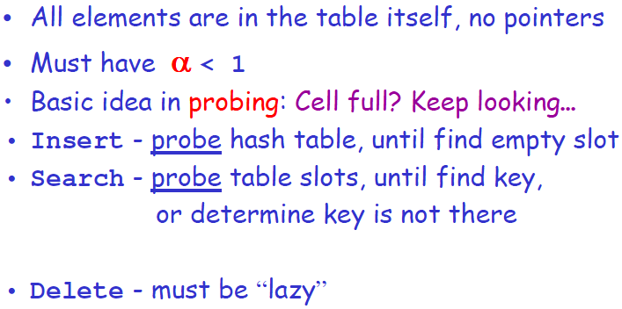
Open Addressing (Probing)

Slide 20
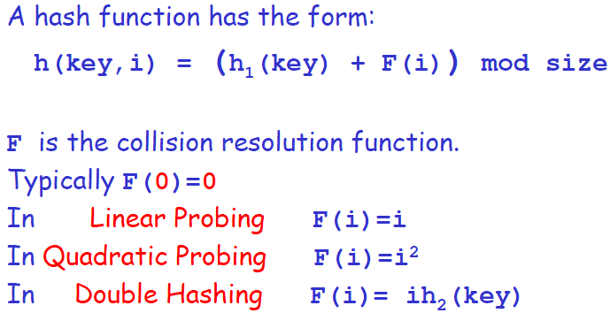
Probing Schemes

Slide 21
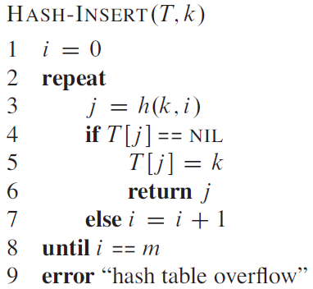
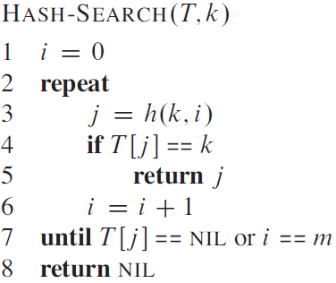
Hash-Insert with Probing Schemes

Slide 22
Linear Probing

Slide 23
Quadratic Probing

Slide 24
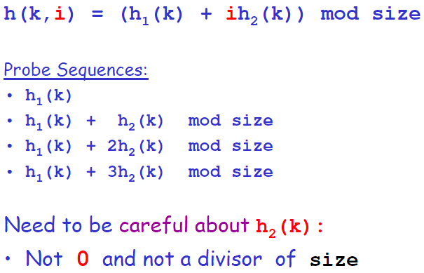
Double Hashing

Slide 25
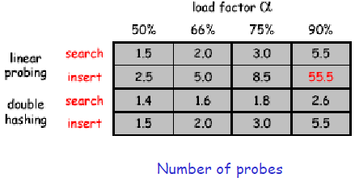
Rules of Thumb
Separate chaining is simple but wastes space
Linear Probing is fast when tables are sparse
Double hashing is fast but needs careful implementation

Slide 26
Universal Hashing

Slide 27
Performance of Universal hashing

Slide 28
Handling load by Rehashing

Slide 29
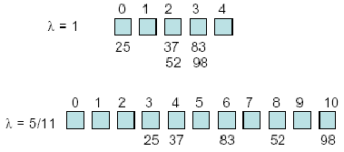
Rehashing Example

Slide 30
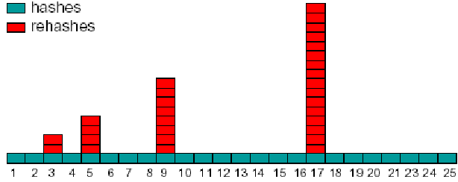
Rehashing Intuition
Starting with table of size 2, double when load factor exceeds 1:

Slide 31
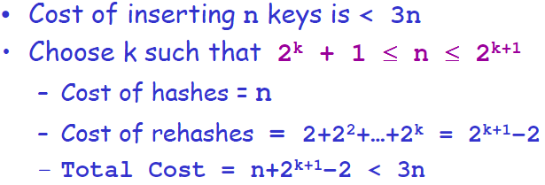
Amortized Analysis of Rehashing

Slide 32
Homework 4
Hw04-GuiQtScribble
Deadline: 22:00, Oct. ?, 2011

