Slide 1
Data Structure & Algorithm
12 – Shortest Path
JJCAO
Steal some from Prof. Yoram Moses & Princeton COS 226

Slide 2
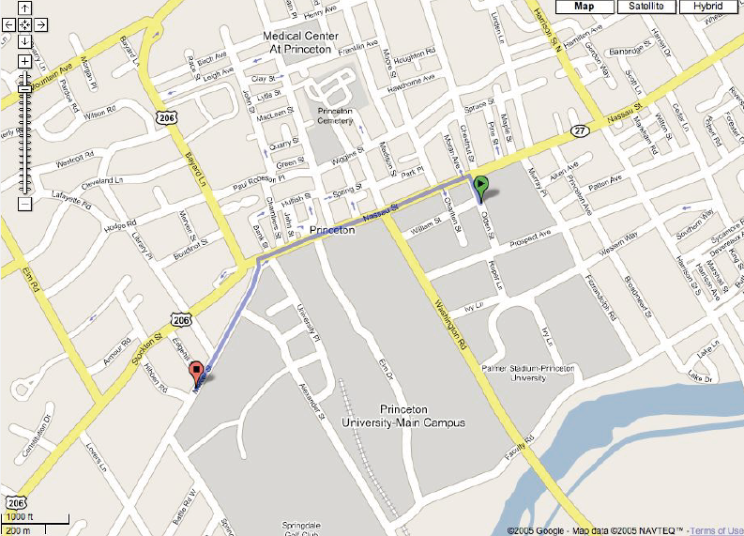
Google Map

Slide 3
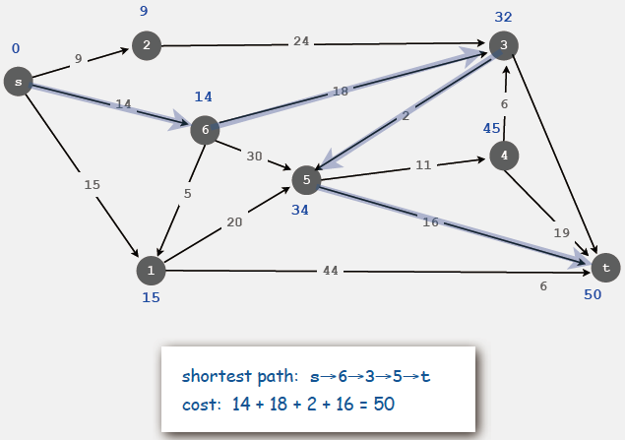
Source to destination Shortest path
Given a weighted digraph G, find the shortest directed path from s to t.

Slide 4
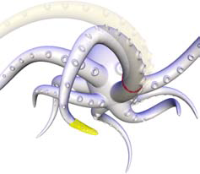
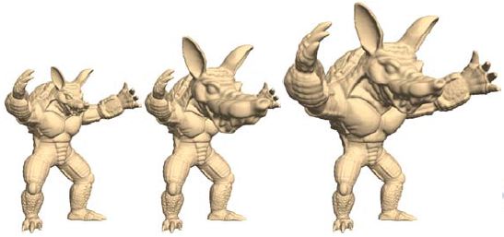
Shortest Path & Geodesics in Shape Deformation
Lipman, Yaron and Sorkine, Olga and Levin, David and Cohen-Or, Daniel. Linear rotation-invariant coordinates for meshes. SIGGRAPH '05.

Slide 5
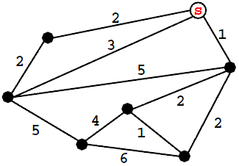
Shortest Path Problems
Edge-weighted graphs G=(V,E), wt
Shortest-path variants:
Source to destination s-t: δ(s,t)
Source s to all other vertices: δ(s,v) for all v in V
All pairs: δ(u,v) for all u,v in V

Slide 6
Early history of shortest paths algorithms
Shimbel (1955). Information networks.
Ford (1956). RAND, economics of transportation.
Leyzorek, Gray, Johnson, Ladew, Meaker, Petry, Seitz (1957). Combat Development Dept. of the Army Electronic Proving Ground.
Dantzig (1958). Simplex method for linear programming.
Bellman (1958). Dynamic programming.
Moore (1959). Routing long-distance telephone calls for Bell Labs.
Dijkstra (1959). Simpler and faster version of Ford's algorithm.

Slide 7
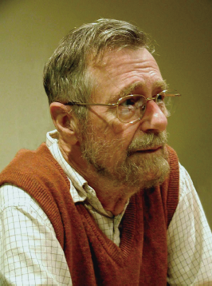
Edsger W. Dijkstra: select quotes
“ The question of whether computers can think is like the question of whether submarines can swim. ”
“ In their capacity as a tool, computers will be but a ripple on the surface of our culture. In their capacity as intellectual challenge, they are without precedent in the cultural history of mankind. ”
“ Do only what only you can do. ”
Edger Dijkstra
Turing award 1972
艾兹格·迪科斯彻

Slide 8
Edsger W. Dijkstra: select quotes
编程的艺术就是处理复杂性的艺术。
简单是可靠的先决条件。
优秀的程序员很清楚自己的能力是有限的，所以他对待编程任务的态度是完全谦卑的，特别是，他们会象逃避瘟疫那样逃避 “聪明的技巧”。 ——1972年图灵奖演讲
我们所使用的工具深刻地影响我们的思考习惯，从而也影响了我们的思考能力。
实际上如果一个程序员先学了BASIC，那就很难教会他好的编程技术了：作为一个可能的程序员，他们的神经已经错乱了，而且无法康复。
就语言的使用问题：根本不可能用一把钝斧子削好铅笔，而换成十把钝斧子会是事情变成大灾难。
“ The use of COBOL cripples the mind; its teaching should, therefore, be regarded as a criminal offence. ”
“ APL is a mistake, carried through to perfection. It is the language of the future for the programming techniques of the past: it creates a new generation of coding bums. ”

Slide 9
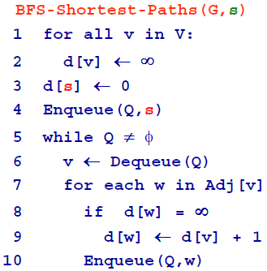
BFS for Shortest Paths
Good if
wt(e)=1 for all
edges e

Slide 10
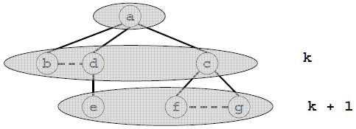
BFS
Lemma: At the end of BSF(G,s): d[v] = δ(s,v)
Proof sketch:
By induction on k = δ(s,v)

Slide 11
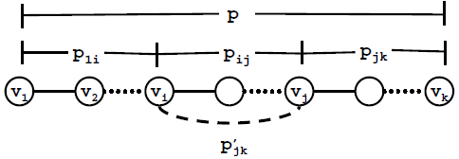
Shortest Path Properties
Lemma:
A sub-path of a shortest path is also a shortest path
Proof:
By contradiction

Slide 12
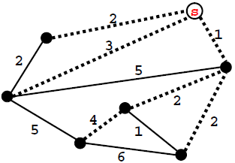
Shortest Paths Trees
Note:
For every node s we can find a tree of shortest paths
rooted at s (e.g. the BFS tree)

Slide 13
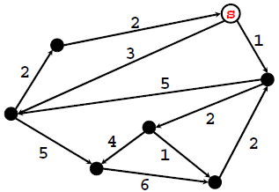
Single-source Shortest Paths
Edge weighted, directed graph
From Source s to all other vertices
Assume Non-negative weights

Slide 14
SSSP – Dijkstra’s algorithm
Input: a directed graph G, with non-negative edge weights, a specific source vertex - s in V[G]
Idea: a shortest path between two vertices contains other shortest paths
Greedy approach: at each step find the closest remaining vertex (closest to the source s)

Slide 15
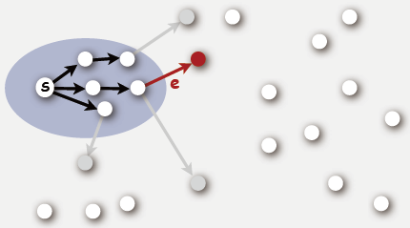
Idea of Dijkstra's algorithm
Start with vertex s and greedily grow tree T
find cheapest path ending in an edge e with exactly one endpoint in T
add e to T
continue until no edges leave T

Slide 16
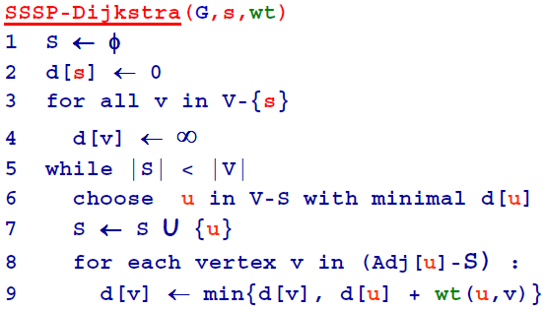
SSSP-Dijkstra

Slide 17
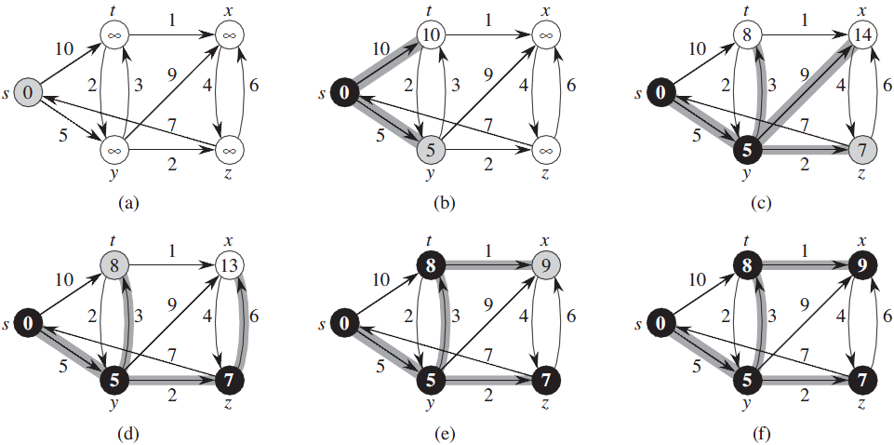
Example

Slide 18
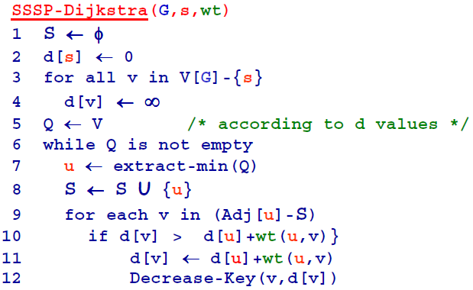
SSSP-Dijkstra using a min-Heap

Slide 19
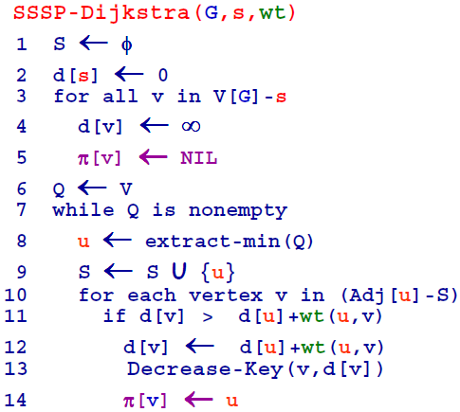
SSSP-Dijkstra (with parents π)

Slide 20
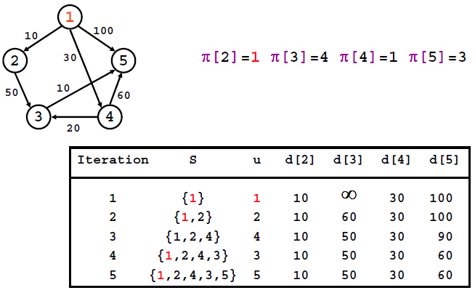
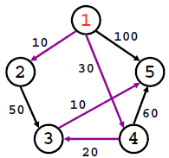
Example

Slide 21
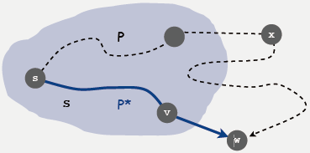
Dijkstra's algorithm: correctness proof
Theorem: At the end of the Dijkstra algorithm, d[w]= δ(s,w) holds for every w in V[G]
Pf. (by induction on |T|)
Let w be next vertex added to T.
Let P* be the s->w path through v.
Consider any other s-> w path P, and let x be first node on path outside T.
P is already as long as P* as soon as it reaches x by greedy choice.
Thus, d[w] is the length of the shortest path from s to w.

Slide 22
Dijkstra using an Array

Slide 23
Dijkstra using a Heap

Slide 24
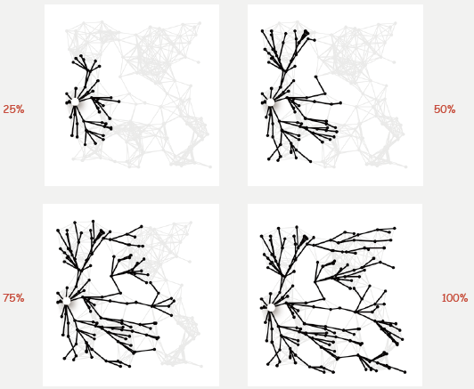
Shortest path trees
Remark. Dijkstra examines vertices in increasing distance from source.

Slide 25
Priority-first search
Insight. All of our graph-search methods are the same algorithm!
Maintain a set of explored vertices S.
Grow S by exploring edges with exactly one endpoint leaving S.
DFS. Take edge from vertex which was discovered most recently.
BFS. Take edge from vertex which was discovered least recently.
Prim. Take edge of minimum weight.
Dijkstra. Take edge to vertex that is closest to s.
Challenge. Express this insight in reusable C++ code

Slide 26
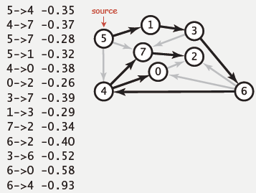
Acyclic networks
Suppose that a network has no cycles.
Q. Is it easier to find shortest paths than in a general network?
A. Yes!
A. AND negative weights are no problem

Slide 27
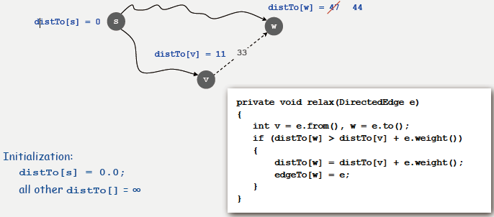
A key operation
Relax edge e from v to w.
distTo[v] is length of some path from s to v.
distTo[w] is length of some path from s to w.
If v->w gives a shorter path to w through v, update distTo[w] and edgeTo[w].

Slide 28
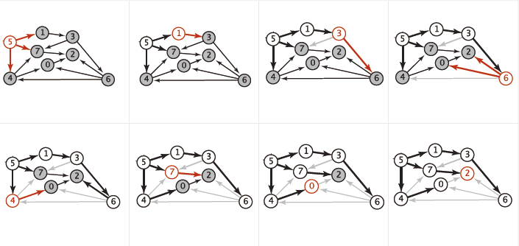
Shortest paths in acyclic networks
Algorithm:
Consider vertices in topologically sorted order
Relax all outgoing edges incident from vertex

Slide 29
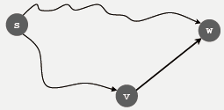
Shortest paths in acyclic networks
Algorithm:
Consider vertices in topologically sorted order
Relax all outgoing edges incident from vertex
Proposition. Shortest path to each vertex is known before its edges are relaxed
Proof (strong induction)
let v->w be the last edge on the shortest path from s to w.
v appears before w in the topological sort
shortest path to v is known before its edges are relaxed
v’s edges are relaxed before w’s edges are relaxed, including v->w
therefore, shortest path to w is known before w’s edges are relaxed.

Slide 30
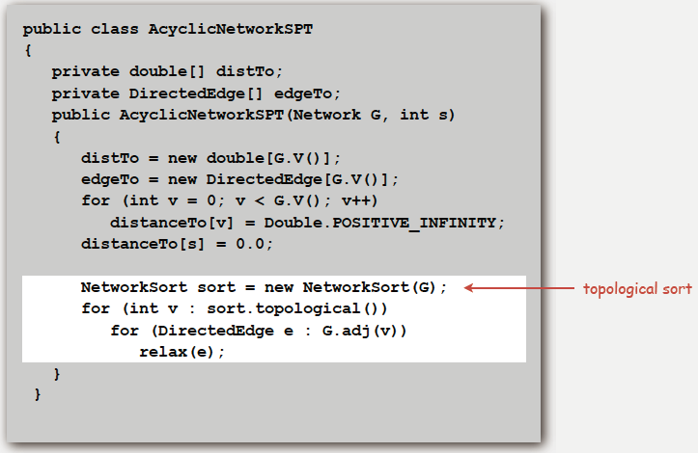
Shortest paths in acyclic networks

Slide 31
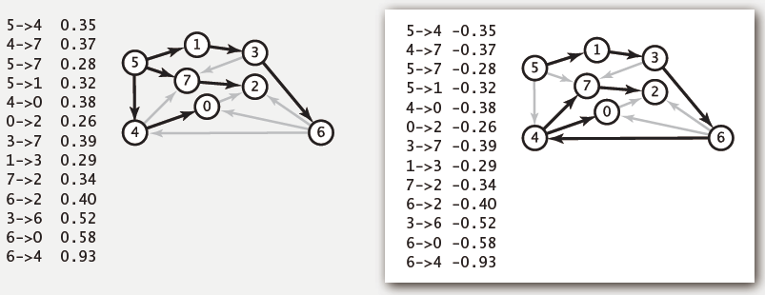
Longest paths in acyclic networks
Algorithm:
Negate all weights
Find shortest path
Negate weights in result

Slide 32
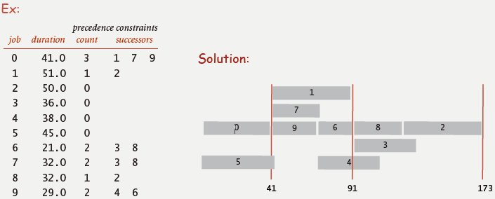
Longest paths in acyclic networks: application
Job scheduling. Given a set of jobs, with durations and precedence constraints, schedule the jobs (find a start time for each) so as to achieve the minimum completion time while respecting the constraints

Slide 33
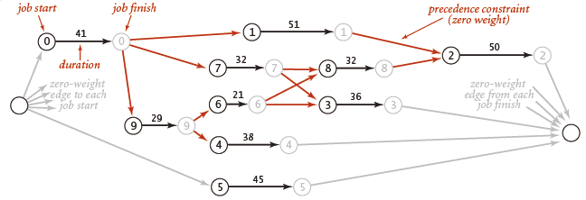
Critical path method
CPM. To solve a job-scheduling problem, create a network
source, sink
two vertices (begin and end) for each job
three edges for each job
begin to end (weighted by duration)
source to begin
end to sink
CPM: Use longest path from the source to schedule each job

Slide 34
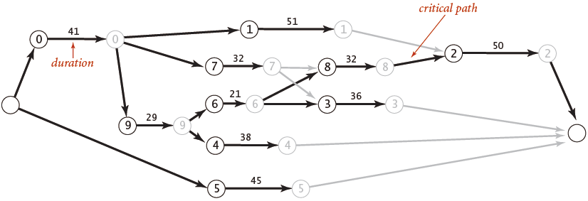
Critical path method
Use longest path from the source to schedule each job.

Slide 35
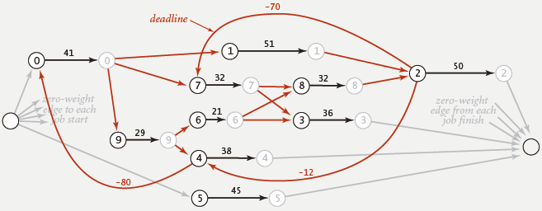
Deep water
Add deadlines to the job-scheduling problem.
Ex. “Job 2 must start no later than 70 time units after job 7.”
Or, “Job 7 must start no earlier than 70 times units before job 2”
Need to solve longest paths problem in general networks (cycles, neg weights).
Possibility of infeasible problem (negative cycles)

Slide 36
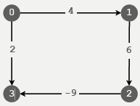
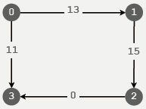
Shortest paths with negative weights: failed attempts
Dijkstra. Doesn’t work with negative edge weights.
Re-weighting. Add a constant to every edge weight also doesn’t work.
Bad news. Need a different algorithm.
Previous algorithm works, but if …
Dijkstra selects vertex 3 immediately after 0.
But shortest path from 0 to 3 is 0->1->2->3.
Adding 9 to each edge changes the shortest path;
wrong thing to do for paths with many edges.

Slide 37
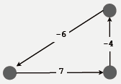
Negative cycles
Def. A negative cycle is a directed cycle whose sum of edge weights is negative.
Observations. If negative cycle C is on a path from s to t, then shortest path can be made arbitrarily negative by spinning around cycle.
Worse news. Need a different problem.

Slide 38
Shortest paths with negative weights
Problem 1. Does a given digraph contain a negative cycle?
Problem 2. Find the shortest simple path from s to t.
Bad news. Problem 2 is intractable.
Good news. Can solve problem 1 in O(VE) steps;
if no negative cycles, can solve problem 2 with same algorithm!

Slide 39
Shortest paths with negative weights: dynamic programming algorithm
A simple solution that works!
Initialize distTo[v] = ∞, distTo[s]= 0.
Repeat V times: relax each edge e.
Negative cycle exists!
Notes:
Another “for” to check negative cycle

Slide 40
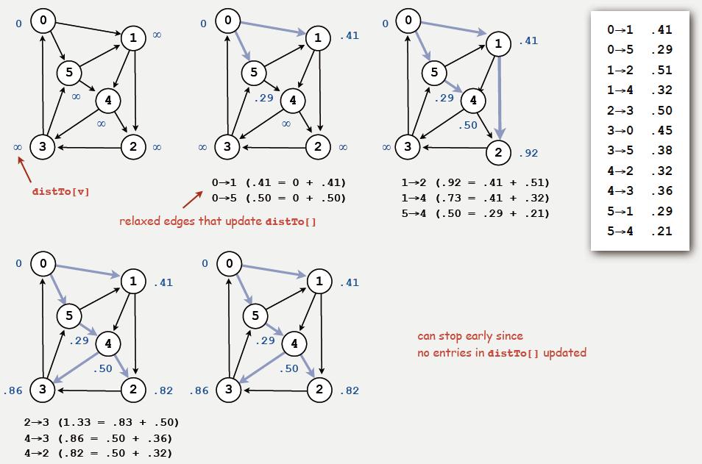
Dynamic programming algorithm trace
Phase 1, 2, …, 5

Slide 41
Dynamic programming algorithm: analysis
Running time. Proportional to E V.
Proposition. If there are no negative cycles, upon termination distTo[v] is the length of the shortest path from from s to v, and edgeTo[] gives the shortest paths.

Slide 42
Bellman-Ford-Moore algorithm
Observation. If distTo[v] doesn't change during phase i, no need to relax any edge leaving v in phase i+1.
FIFO implementation. Maintain queue of vertices whose distance changed.
Running time.
Proportional to EV in worst case.
Much faster than that in practice.
be careful to keep at most one copy of each vertex on queue

Slide 43
Bellman-Ford-Moore algorithm

Slide 44
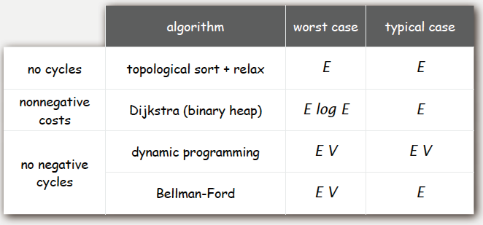
Single source shortest paths implementation: cost summary
Remark 1. Cycles make the problem harder.
Remark 2. Negative weights make the problem harder.
Remark 3. Negative cycles makes the problem intractable.

Slide 45
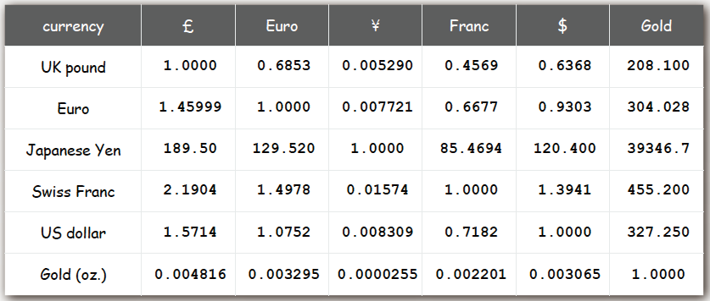
Currency conversion
Problem. Given currencies and exchange rates, what is best way to convert one ounce of gold to US dollars?

Slide 46
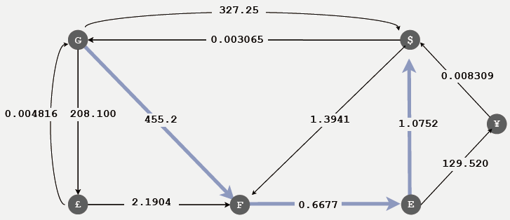
Currency conversion - Graph formulation
Vertex = currency.
Edge = transaction, with weight equal to exchange rate.
Find path that maximizes product of weights.
Challenge. Express as a shortest path problem.

Slide 47
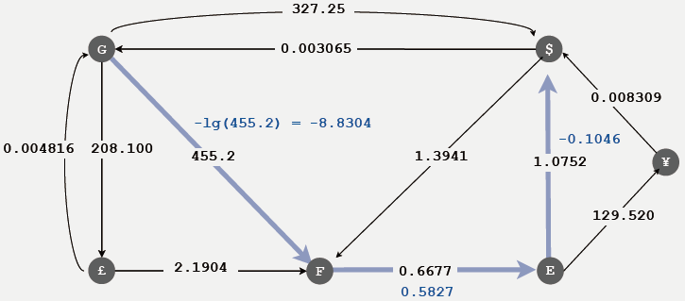
Currency conversion - Graph formulation
Reduce to shortest path problem by taking logs
Let weight of edge v->w be - lg (exchange rate from currency v to w).
Multiplication turns to addition.
Shortest path with given weights corresponds to best exchange sequence.
Challenge. Solve shortest path problem with negative weights.

Slide 48
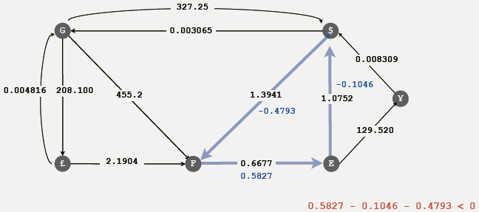
Shortest paths application: arbitrage
Is there an arbitrage opportunity in currency graph?
Ex: $1 => 1.3941 Francs => 0.9308 Euros => $1.00084.
Is there a negative cost cycle?
Remark. Fastest algorithm is valuable!

Slide 49
Negative cycle detection
If there is a negative cycle reachable from s.
Bellman-Ford-Moore gets stuck in loop, updating vertices in cycle.
Proposition. If any vertex v is updated in phase V, there exists a negative cycle, and we can trace back edgeTo[v] to find it.

Slide 50
Shortest paths summary
Dijkstra’s algorithm.
Nearly linear-time when weights are nonnegative.
Generalization encompasses DFS, BFS, and Prim.
Acyclic networks.
Arise in applications.
Faster than Dijkstra’s algorithm.
Negative weights are no problem.
Negative weights.
Arise in applications.
If negative cycles, shortest simple-paths problem is intractable !
If no negative cycles, solvable via classic algorithms.
Shortest-paths is a broadly useful problem-solving model.

