Slide 1
05 Geodesics on Meshes
jjcao
Based on the idea of Professor Ligang Liu

Slide 2
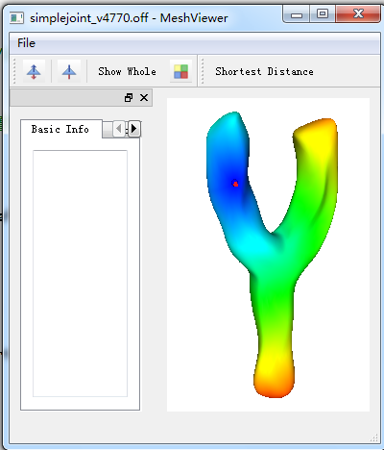
Demo

Slide 3
Requirements
Use libQGLViewer as the GUI
Load a mesh (*.off) by CGAL
Use CGAL::Polyhedron_3 as the data structure for the mesh
Display the mesh
Select & unselect one vertex of the mesh
Compute geodesic distance from the vertex to all other vertices & draw the mesh with vertex color specified by the distances.
Select two vertices, draw a geodesic between them
Visualize other graph algorithms, such as BFS [advance]
Note: may refer to The Boost Graph Library for graph structures and algorithms. But the library is hard to use for beginners.

Slide 4
The objective
OpenGL basics
Halfedge structure of CGAL
3D graphics programming based on libQGLViewer
GUI programming by QT
Graph data structure & shortest path algorithms

Slide 5
The process
12-OpenGL.pptx
13-libQGLViewer.pptx
20.1-Halfedge.pptx
Imitate the base project in hw05_GeodesicsOnMeshes.rar

